Slide 1
INTRODUCTION TO THE RELATIONAL
MODEL

Slide 2
The relational model remains the primary data model for commercial data-processing applications because of its simplicity.
Relational Model (RM) represents the database as a collection of relations.
A relation is a table of values.
Every row in the table represents a collection of related data values.
These rows in the table denote a real-world entity or relationship.

Slide 3
Structure of Relational Databases
Database Schema
Keys
Schema Diagrams
Relational Query Languages
The Relational Algebra

Slide 4
i.Structure of Relational Databases
A relational database consists of a collection of tables, each of which is assigned a unique name.
A row in a table represents a relationship among a set of values.
There is a close correspondence between the concept of table and the mathematical concept of relation, from which the relational
data model takes its name

Slide 5
A tuple is simply a sequence(or list) of values.
A relationship between n values is represented mathematically by an n-tuple of values, that is, a tuple with n values, which corresponds to a row in a table.
In the relational model, relation is used to refer to a table.
Tuple is used to refer to a row.
Attribute refers to a column of a table.

Slide 6
Relation instance to refer to a specific instance of a relation, that is, containing a specific set of rows.
For each attribute of a relation, there is a set of permitted values, called the domain of that attribute.
A domain is atomic if elements of the domain are considered to be indivisible units.

Slide 7
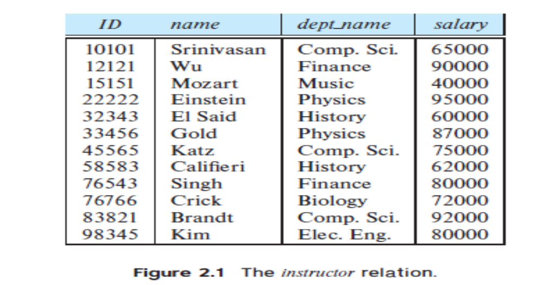
The null value is a special value that signifies that the value is unknown or does not exist.

Slide 8
Example: Instructor table
Four column headers: ID, name, dept name and salary. Instructor table has four attributes:ID, name, dept name, and salary.
Each row of this table records information about an instructor.
Each instructor is identified by the value of the column ID.

Slide 9
The instance of instructor has 12 tuples, corresponding to 12 instructors.
The domain of the salary attribute of the instructor relation is the set of all possible salary values, while the domain of the name attribute is the set of all possible instructor names.

Slide 10
Suppose the table instructor had an attribute phone number, which can store a set of phone numbers corresponding to the instructor.
Then the domain of phone number would not be atomic, since an element of the domain is a set of phone numbers, and it has subparts, namely, the individual phone numbers in the set.

Slide 11
Suppose as before that we include the attribute phone number in the instructor relation.
It may be that an instructor does not have a phone number at all, or that the telephone number is unlisted.
We use the null value to signify that the value is unknown or does not exist.

Slide 12
ii.Database Schema
Database schema is the logical design of the database.
Database instance is a snapshot of the data in the database at a given instant in time.
A relation corresponds to the programming-language notion of a variable.

Slide 13
A relation schema corresponds to the programming language notion of type definition.
A relation schema consists of a list of attributes and their corresponding domains.
A relation instance corresponds to the programming-language notion of a value of a variable.

Slide 14
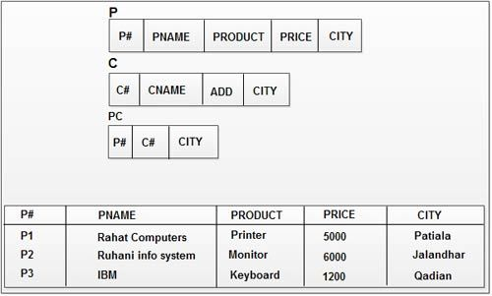
We often use the same name, such as instructor, to refer to both the schema and the instance

Slide 15
iii. Keys
A superkey is a set of one or more attributes that, taken collectively, allow us to identify uniquely a tuple in the relation.
For example, the ID attribute of the relation instructor is sufficient to distinguish one instructor tuple from another. Thus, ID is a superkey.
The name attribute of instructor, on the other hand, is not a superkey, because several instructors might have the same name.

Slide 16
CANDIDATE KEY is a set of attributes that uniquely identify tuples in a table.
Candidate Key is a super key with no repeated attributes.
The Primary key should be selected from the candidate keys.
Every table must have at least a single candidate key.
A table can have multiple candidate keys but only a single primary key.

Slide 17
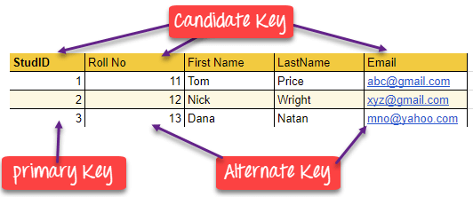

Slide 18
PRIMARY KEY
The PRIMARY KEY constraint uniquely identifies each record in a database table.
Primary keys must contain UNIQUE values.
It is a unique identifier, such as a driver license number, telephone number (including area code), or vehicle identification number (VIN).

Slide 19
2. Foreign Key Constraints
A foreign key is a field (or collection of fields) in one table that uniquely identifies a row of another table.
The foreign key is defined in a second table, but it refers to the primary key in the first table.

Slide 20
CREATE TABLE emp(empid varchar(5) primary key,ename varchar(10),age int,address varchar(20),mob int);
Create table transaction(tid varchar(5),amt float,transemp varchar(5),foreign key(transemp) references emp(empid);

Slide 21
Primary Key | Foreign Key
Primary key uniquely identify a record in the table. | Foreign key is a field in the table that is primary key in another table.
Primary Key can't accept null values. | Foreign key can accept multiple null value.
We can have only one Primary key in a table. | We can have more than one foreign key in a table

Slide 22
iv. Schema Diagrams
A database schema, along with primary key and foreign-key constraints, can be depicted by schema diagrams.
Each relation appears as a box with the relation name at the top in blue
The attributes are listed inside the box.

Slide 23
Primary-key attributes are shown underlined.
Foreign-key constraints appear as arrows from the foreign-key attributes of the referencing relation to the primary key of the referenced relation.
We use a two-headed arrow, instead of a single-headed arrow, to indicate a referential integrity constraint that is not a foreign-key constraints.

Slide 24
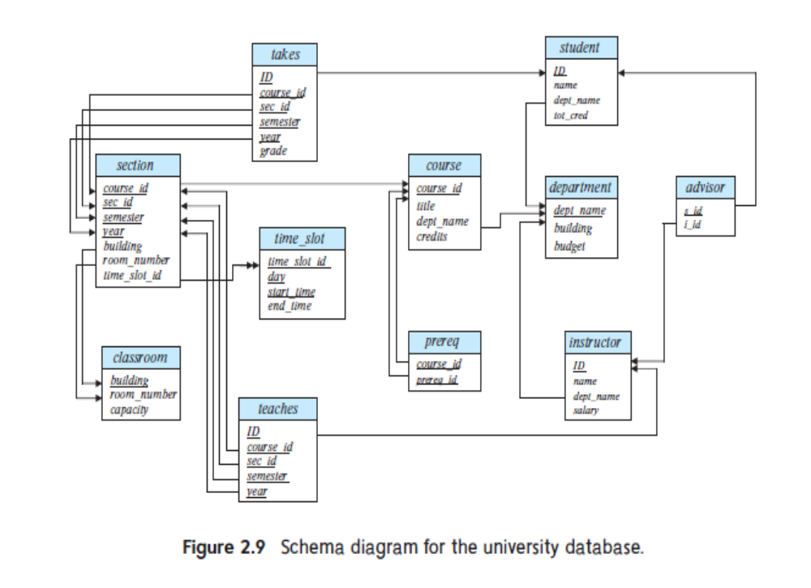

Slide 25
v. Relational Query Languages
A query language is a language in which a user requests information from the database.
Query languages can be categorized as
      imperative
      Functional
      declarative.

Slide 26
In an imperative query language, the user instructs the system to perform a specific sequence of operations on the database to compute the desired result.
These languages usually have a notion of state variables, which are updated in the course of the computation.

Slide 27
In a functional query language, the computation is expressed as the evaluation of functions that may operate on data in the database or on the results of other functions.
The functions are side-effect free and they do not update the program state.

Slide 28
In a declarative query language, the user describes the desired information without giving a specificsequence of steps or function calls for obtaining that information.
The desired information is typically described using some form of mathematical logic.
It is the job of the database system to figure out how to obtain the desired information.

Slide 29
vi. Relational Algebra
Relational algebra consists of a set of operators that consume either one or two relations as input and produces one relation as its output.
Unary operators include: select, project, and rename
Binary operators include: Cartesian product, equality join, natural join, join, semi-join, division, union, and set difference.
DBMS

Slide 30
Select Operation
The select operation selects tuples that satisfy a given predicate.
We use the lowercaseGreek letter sigma (σ) to denote selection.
The predicate appears as a subscript to σ.
The argument relation is in parentheses after the σ.

Slide 31
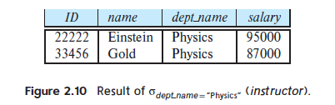
Thus, to select those tuples of the instructor relation where the instructor is in the “Physics” department, we write: σ _{dept name =“Physics”} (instructor)

Slide 32
We can combine several predicates into a larger predicate by using the connectives and (∧), or (∨), and not (.).
Thus, to find the instructors in Physics with a salary greater than $90,000, we write:
  σ dept name =“Physics” ∧ salary>90000 (instructor)

Slide 33
The Project Operation
The project operation allows us to produce this relation.
It is a unary operator that eliminate duplicates.
Projection is denoted by the uppercase Greek letter pi (Π).
We list those attributes that we wish to appear in
the result as a subscript to Π.
The argument relation follows in parentheses. We write the query to produce such a list as:
      Π_{ID, name, salary}(instructor)

Slide 34
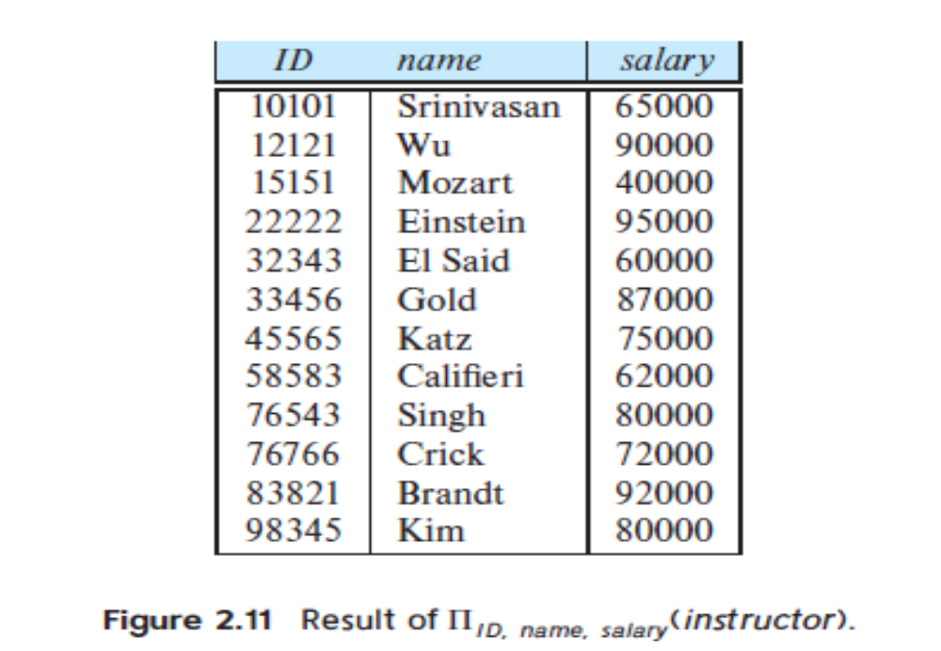

Slide 35
Composition of Relational Operations
Relational-algebra operations can be composed together into a relational-algebra expression.
Composing relational-algebra operations into relational algebra expressions is just like composing arithmetic operations (such as +, −, ∗, and ÷) into arithmetic expressions.

Slide 36
“Find the names of all instructors in the Physics department.” We write:
    Π _{name} (σ _{dept name =“Physics”} (instructor))

Slide 37
The Cartesian-Product Operation
The Cartesian-product operation, denoted by a cross (×), allows us to combine information from any two relations.
We write the Cartesian product of relations r1 and r2 as r1 × r2.

Slide 38
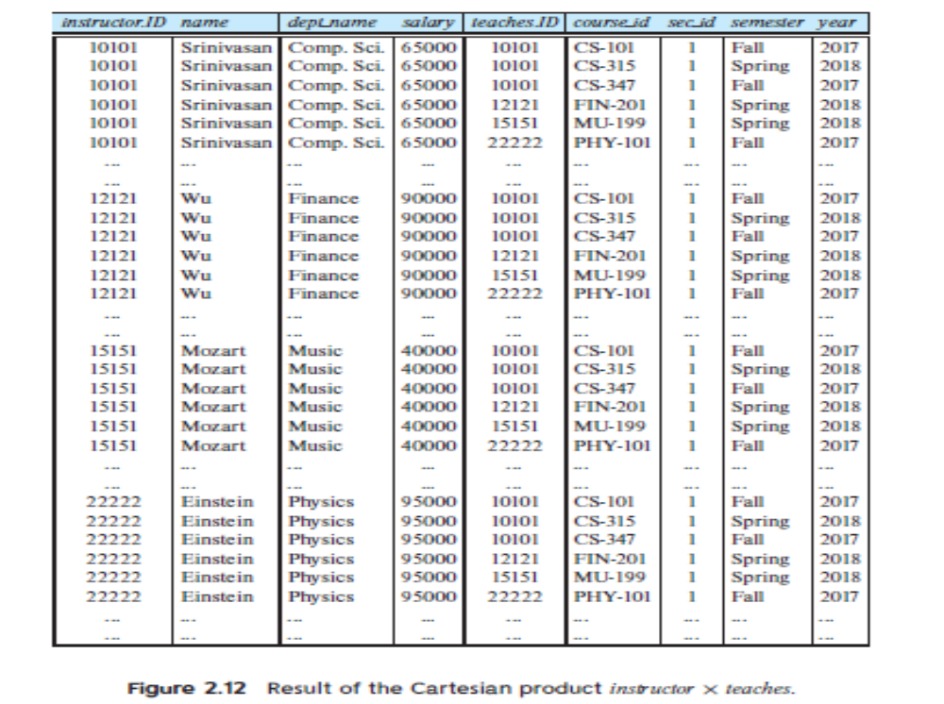

Slide 39
For example, the relation schema for r = instructor × teaches is:
(instructor.ID, instructor.name, instructor.dept name, instructor.salary,teaches.ID, teaches.course id, teaches.sec id, teaches.semester, teaches.year)

Slide 40
Join operation
A Cartesian product with a condition applied:
R ⋈ <condition> S

Slide 41
Theta Join - Example
Students Courses
stud# name course course# name
100 Fred PH PH Pharmacy
200 Dave CM CM Computing
300 Bob CM
Students ⋈ _{stud# = 200} Courses
stud# Students.name course course# Courses.name
200 Dave CM PH Pharmacy
200 Dave CM CM Computing

Slide 42
Set Operations
Union puts all tuples of two relations in one relation. To use this operator, two conditions must hold:
  The two relations must be of the same degree.
  The domain of i^{th} attribute of the two participating relation must be the same.
Set difference operator computes tuples that are in one relation, but not in another.
Set intersect operator computes tuples that are common in two relations:

Slide 43
Example
R
name
address
gender
birthdate
Carrie Fisher
123 Maple St., Hollywood
F
9/9/99
Mark Hamil
456 Oak Rd., Brentwood
M
8/8/88
S
name
address
gender
birthdate
Carrie Fisher
123 Maple St., Hollywood
F
9/9/99
Harrison Ford
789 Palm Dr., Beverly Hills
M
7/7/77

Slide 44
Sample Operations
R ∩ S
name
address
gender
birthdate
Carrie Fisher
123 Maple St., Hollywood
F
9/9/99
R ∪ S
name
address
gender
birthdate
Carrie Fisher
123 Maple St., Hollywood
F
9/9/99
Harrison Ford
789 Palm Dr., Beverly Hills
M
7/7/77
Mark Hamil
456 Oak Rd., Brentwood
M
8/8/88
R - S
name
address
gender
birthdate
Mark Hamil
456 Oak Rd., Brentwood
M
8/8/88

Slide 45
The Assignment Operation
The assignment operation, denoted by ←, works like assignment in a programming language.
courses fall 2017 ← Πcourse id(σsemester =“Fall”∧ year=2017 (section))
courses spring 2018 ← Πcourse id(σsemester =“Spring” ∧ year=2018 (section))
courses fall 2017 ∩ courses spring 2018

Slide 46
The result of the expression to the right of the ← is assigned to the relation variable on the left of the ←.
This relation variable may be used in subsequent expressions.

